Slide 1

Introduction to the software R
Series of webinars on Strategies to calculate LFS sample weights using Calibration.
4-13 March 2025
Antonio R. DISCENZA
Senior Labour Statistician - ILO Department of Statistics - discenza@ilo.org

Slide 2
Outline
Introduction to the software R
Starting with R
  Introduction to R
  Scalars and vectors
  DataFrames
  Parameterization of paths and filenames
Installation and use of R packages

Slide 3
The statistical software R

Slide 4
R software
R is a free software environment for statistical computing and graphics.
  It compiles and runs on a wide variety of UNIX platforms, Windows and MacOS.
R is an integrated suite of software facilities for:
  data manipulation (storage, handling)
  calculations (on arrays and matrices),
  data analysis (with a large collection of tools, linear and nonlinear modelling, statistical tests, time series analysis, classification, clustering, etc. )
  graphical display (on screen and hardcopy).
  R allows users to add additional functionality by defining new functions.
  Functions for a wide range of modern statistics have been developed in packages by R contributors and made available for free to the R community

Slide 5
The Comprehensive R Archive Network (CRAN)
CRAN is a network of servers around the world that store code and documentation for R
  Official website
https://cran.r-project.org/
  R binaries to install R on windows for the first time
https://cran.r-project.org/bin/windows/base/

Slide 6
R Help on the Internet - free resourses
The official R Manuals:
https://cran.r-project.org/manuals.html
Contributed documentation (Manuals, tutorials, etc.) in different languages, provided by users of R
https://cran.r-project.org/other-docs.html
CRAN Task Views
  guidance on packages on CRAN relevant for tasks related to a certain topic.
https://cran.r-project.org/web/views/
CRAN Task View: Official Statistics & Survey Statistics
  list of packages with methods typically used in official statistics and survey statistics.
https://cran.r-project.org/web/views/OfficialStatistics.html

Slide 7
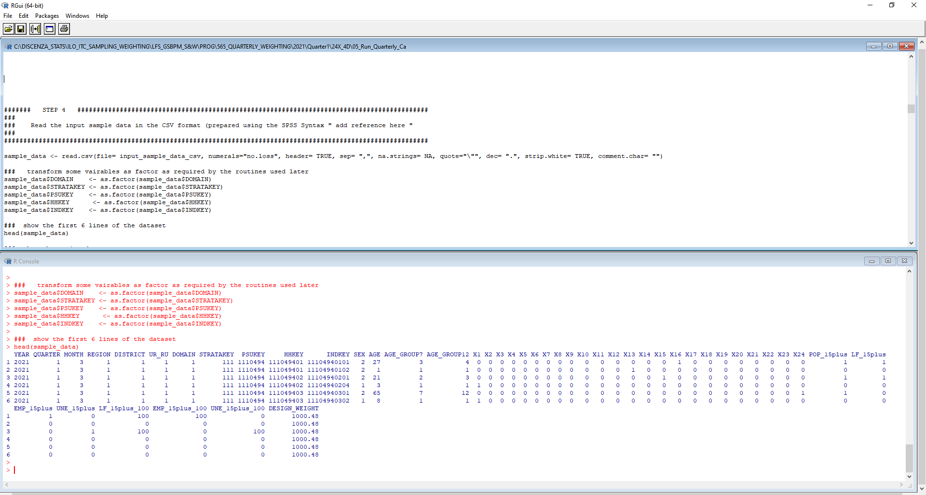
R Gui
Scripts
(syntax file)
R Console.
Output and command line

Slide 8
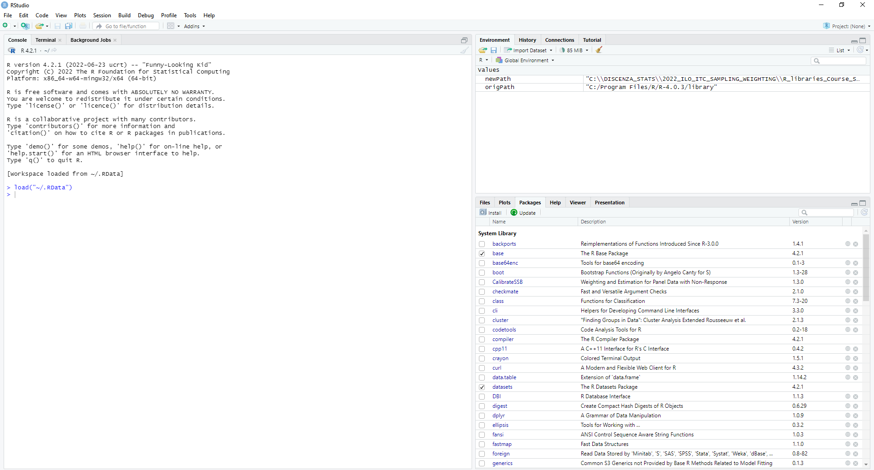
R Studio
An integrated development environment for R

Slide 9
Starting with R

Slide 10
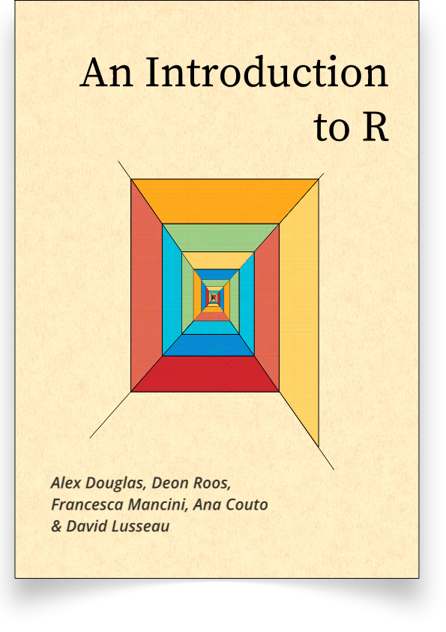
Starting with R
There are plenty of books explaining how to program in R
A very useful online book to start learning R
An Introduction to R
Alex Douglas, Deon Roos, Francesca Mancini, Ana Couto & David Lusseau
September 23, 2022
Made available for free by the authors on the web at the following link https://intro2r.com
From the preface [The aim of this book is to introduce you to using R … to help you climb the initial learning curve and provide you with the basic skills and experience (and confidence!) to enable you to further your experience in using R. … Our book assumes that you have no previous experience of using either R or RStudio and no background in programming ]
We will be using some content from this book to recall the basic elements or R

Slide 11
R objects
“…everything in R is an object. These objects can be almost anything, from a single number or character string (like a word) to highly complex structures like the output of a plot, a summary of your statistical analysis or a set of R commands that perform a specific task”.
  We can have different type of data:
    Numeric,
    Integers (i.e. numbers without decimals)
    Characters (i.e. strings)
    Factors (i.e. characters with additional attributes such as levels or orders)
    Logical (True or False)

Slide 12
Data Frames
“By far the most commonly used data structure to store data in is the data frame. A data frame is a powerful two-dimensional object made up of rows and columns which looks superficially very similar to a matrix. However, whilst matrices are restricted to containing data all of the same type, data frames can contain a mixture of different types of data. Typically, in a data frame each row corresponds to an individual observation and each column corresponds to a different measured or recorded variable.”
We immediately recognize that R data frames is exactly what we need to store the typical microdata from household surveys (like those in SPSS, SAS, STATA, etc.)
Vectors
Sequence of data elements of the same type
Scalars
“Are vectors that have a single value (length 1)”

Slide 13
R programming
R is case sensitive, so the object “Year” is different from the object “year”, and the same is for the functions
Very often we need to read from external files and create a dataframe.
  A solution that works well is to read from CSV files (Comma Separed Values)
    Make sure the column names do not have spaces and symbols
    The file path has to be separeted with a single forward slash /
  Similarly we can produce CSV files as output that can be imported by other software
If we want to save R objects in a file to use them again in a new session we need to save their «image» in a file with extension «.Rdata”
  We use save.image(file = “my_objects.Rdata") to save the objects
  We use load(file = “my_objects.Rdata") to reload the objects later and reuse them
  The command ls() lists all the objects available/created in the session

Slide 14
Packages and libraries
R packages are extensions to the base R software
  Usually built by R contributors to implement statistical functions
  Made available for free to the R community (the R users) through the CRAN (the Comprehensive R Archive Network) servers
  Typically, we can do the same things using many different functions and packages. It is up to us to decide the one we are more comfortable with
    We can generally find what we need simply asking colleagues or searching the internet

Slide 15
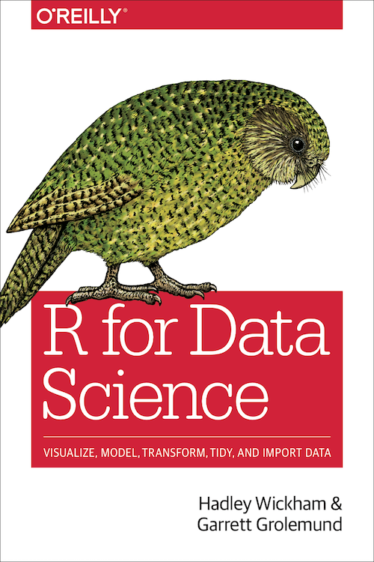
More advanced stuff with R
Another very useful online free book to learn R
“R for Data Science”.
Hadley WicKham & Garrett Grolemund
O’Reilly in January 2017
Made available for free by the authors on the web at the following link https://r4ds.had.co.nz/
From the introduction [The goal of “R for Data Science” is to help you learn the most important tools in R that will allow you to do data science. After reading this book, you’ll have the tools to tackle a wide variety of data science challenges, using the best parts of R.]
We will be using some content from this book

